Slide 1
No. 47

Slide 2

QUADRATIC EQUATIONS
Word Problem on Marks Scored

Slide 3

EX 4.3 5
5. In a class test, sum of Shefali’s marks in Mathematics and English is 30. Had she
got 2 marks more in Mathematics and 3 marks less in English, the product of
their marks would have been 210. Find her marks in the two subjects.
Sol :
Sum of Shefali’s marks in Mathematics and English is 30
Let Shefali’s marks in Mathematics be x
Calculation
∴ Marks in English = (30 – x)
156
∴
x²
- 13x - 12x
+156
= 0
New marks obtained in Mathematics = (x + 2)
2
156
∴
x
(x - 13)
- 12
(x - 13)
= 0
New marks obtained in English =
30 – x
– 3
2
78
What we have to find in this sum ?
= (27 – x)
3
39
–
13
–
12
∴
(x – 13)
(x – 12)
13 + 12
=
25
= 0
Do we know Shefali’s marks in Mathematics
According to the given condition,
13
13
Mathematics + English = 30
∴
x – 13
or
= 0
x – 12
(x + 2)
(27 – x)
= 210
= 0
Find two factors of 156 in such a way that by adding factors we get middle number.
1
∴
or
No
∴
x = 13
x = 12
x (27 – x)
+ 2 (27 – x)
= 210
x + English = 30
∴
if
x = 13
or
x = 12
27x
– x²
+ 54
– 2x
= 210
Since last sign is ‘+’ Give middle sign only to both factors.
∴ English = 30 - x
Multiplying throughout by – 1
Let us do the prime factorization of 156
∴
(30 – x)
=
30 - 13
(30 – x)
∴
=
30 - 12
– x²
+ 27x
– 2x
+ 54
– 210
= 0
‘+’ sign means adding
∴
=
17
=
18
– x²
+ 25x
– 156
= 0
156 × 1 = 156
Shefali’s marks in Mathematics & English are 13, 17 or 12, 18
∴
x²
– 25x
+ 156
1
= 0

Slide 4
No. 48

Slide 5
QUADRATIC EQUATIONS
Sum based on Age

Slide 6
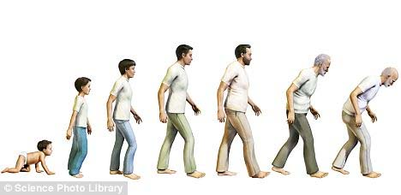
Word Problems Based On AGES

Slide 7




















































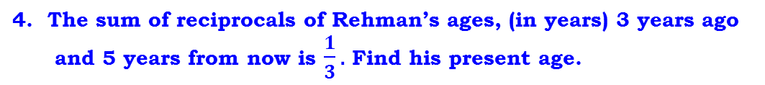
EX 4.3 4
4. The sum of reciprocals of Rehman’s ages, (in years) 3 years ago
and 5 years from now is $\frac{1}{3}.$ Find his present age.
Sol :
Let Rehman’s present age be ‘x’ years
∴
$$3 (2x+2)$$
$$=1(x2+2x −15)$$
Means $\frac{1}{?}$
What we have to find in this sum?
Do we know his present age ?
Rehman’s age 3 years ago
Ago means before
=
= ( ) years
x
– 3
∴
$$6x+6$$
$$=x2+2x −15$$
Means ‘+’
Rehman’s age 5 years from now
=
= ( ) years
x
+ 5
∴
$$0$$
$=x2+2x −15$ – 6x - 6
According to the given condition,
∴
$$0$$
$$=x2−4x −21$$
1
1
$$\frac{1}{3}$$
No
$$+$$
$$=$$
∴
$$x2 −4x −21$$
x - 3
x + 5
1
$$=0$$
∴
‘-’ sign means subtracting
$$x2 −7x+3x −21$$
$$x+5$$
$$+ x −3$$
$$= \frac{1}{3}$$
$$=0$$
∴
Find two factors of 21 in such a way that by subtracting factors we get middle number.
∴
Since last sign is ‘-’ Give middle sign to the bigger factor & opposite sign to smaller factor.
$$\left(x −3\right)(x+5)$$
$$x$$
$$\left(x −7\right)$$
$$+ 3$$
$$(x−7)$$
$$=0$$
$$= \frac{1}{3}$$
∴
21
$$\left(x −7\right)$$
$$2x+2$$
$$(x+3)$$
$$=0$$
∴
∴
$$or$$
$$\left(x −7\right)$$
$$=0$$
$$\left(x+3\right)$$
$$x$$
$$=0$$
$$(x+5)$$
$$–3$$
$$(x+5)$$
7 – 3 = 4
∴
$$2x+2$$
$$= \frac{1}{3}$$
$$x=7$$
$$or$$
$$x=−3$$
∴
∴
$$Age cannot be negative$$
$$x2$$
$$+ 5x$$
$$–3x$$
$$–15$$
–
7
+
3
$$2x+2$$
$$= \frac{1}{3}$$
$$ x ≠−3 ,Hence x=7$$
∴
$$x2$$
$$+ 2x$$
$$−15$$
∴ The present age of Rehman is 7 years

Slide 8
No. 49

Slide 9
QUADRATIC EQUATIONS
Word Problem on Age

Slide 10
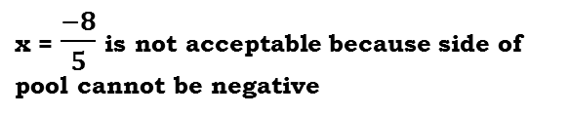



Two years ago my age was 4$\frac{1}{2}$ times the age of my son. Six years ago, my age was twice the square of the age of my son. What is the present age of my son ?
Sol.
Let the present age of my son be x years
Since both are my present age,
So both are equal
What we have to find in this sum ?
What will be my present age ?
 | My Son’s Age | My Age
Present Age
What will be my present age ?
9
(x – 2)
2×(x – 6)²
+ 2
x
+ 6
2
4 ½
(x – 2)
$$My present age=$$
Age 2 yrs ago
x – 2
Age 2 yrs ago
=
9
(x – 2)
2
$$My present age$$
$$=$$
Age 6 yrs ago
Age 6 yrs ago
x – 6
2 ×
(x – 6)²

Slide 11
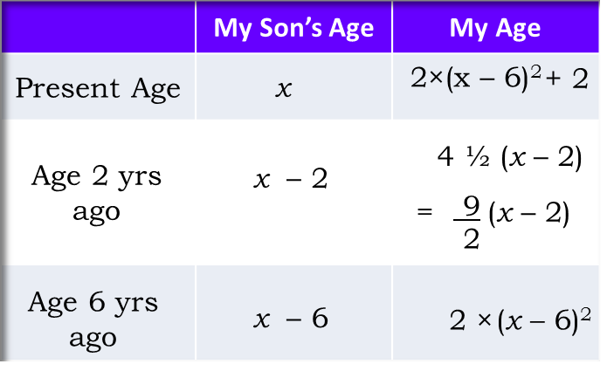























































Two years ago my age was 4$\frac{1}{2}$ times the age of my son. Six years ago, my age was twice the square of the age of my son. What is the present age of my son ?
Sol.
Let the present age of my son be x years
∴
$$x−10$$
=
$$0$$
$$or$$
$$4x−17$$
$$\text{= 0}$$
$$\frac{9}{2}$$
∴
$$x=10$$
$$or$$
4$x=17$
$$(x −2)$$
$$+ 2$$
$$=$$
$$2\left(x–6\right)2$$
$$+ 6$$
Find two factors of 680 in such a way that by adding factors we get middle number.
$$x=10$$
$$or$$
$$x=\frac{17}{4}$$
$$\frac{9}{2}$$
∴
∴
$$(x −2)$$
$$– 2\left(x – 6\right)2$$
$$+ 2$$
$$–6$$
$$=0$$
$$x=\frac{17}{4}$$
If
$$\frac{9}{2}$$
Calculation
$$=\frac{17}{4}−6$$
∴
$$(x −2)$$
$$−$$
$$2\left(x −6\right)2$$
$$− 4=0$$
$$My \text{son}′\text{s} age \text{six} \text{years} \text{ago}$$
$$\text{= }\text{x}\text{ – 6}$$
‘+’ sign means adding
Let us do the prime factorization of 680
$$\frac{9}{2}$$
Since last sign is ‘+’ Give middle sign to both factors.
Multiplying throughout by – 1
$$My present age=$$
$$(x −2)$$
$$+ 2$$
Multiplying throughout by 2, we get
2
680
$$=\frac{17−24 }{4}$$
9 (x – 2) – 4 (x – 6)²
– 8
= 0
2
340
∴
9x
– 18
– 4
(x²
– 12x
+ 36)
– 8
170 × 4 = 680
$$=\frac{−7 }{4}$$
= 0
$$My present age$$
$$=$$
$$2\left(x–6\right)2$$
$$+ 6$$
40 + 17
∴ 9x
– 18
– 4x²
+ 48x
–144
– 8
= 0
=
57
2
170
680
∴
If x $=\frac{17}{4}$
$$my \text{son}′\text{s} age \text{six} \text{years} \text{ago}$$
$$\text{becomes} \text{negative}$$
∴
– $\text{4}x2$
+ $57x$
– $170$
$$\text{= 0}$$
5
85
∴
$$\text{4}x2$$
$$− 57x$$
$$+170$$
$$\text{= 0}$$
17
$$x≠\frac{17}{4}$$
∴
$$\text{4}x2$$
$$− 40x$$
$$− 17x$$
$$+ 170$$
$$\text{= 0}$$
∴
17
$$Hence x=10$$
–
40
–
17
$$4x$$
$$\left(x−10\right)$$
$$−17$$
$$(x−10)$$
$$\text{= 0}$$
1
∴
∴
$$\left(x−10\right) (4x−17)$$
$$\text{= 0}$$
∴ The present age of son is 10 years.

Slide 12
No. 50

Slide 13
QUADRATIC EQUATIONS
Geometric Figures sum based on
right angled triangle

Slide 14
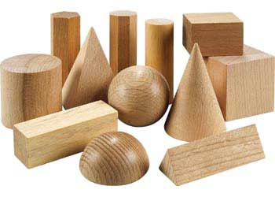
Word Problems Based On Geometric Figures

Slide 15

homework
EX 4.2 5
Q.
The altitude of a right triangle is 7cm less than its base.
If the hypotenuse is 13cm, find the other two sides.
Sol.
Let base of right triangle be x cm
( ) cm
13 cm
∴
Altitude of right triangle
=
x
‒ 7
Calculation
(x – 7) cm
Hypotenuse
=
13cm
In a right triangle,
By Pythagoras Theorem,
2
60
x cm
∴
(x ‒12)
0
(x +5)
2
30
=
Do we know the relation which connects all three sides of $right angled triangle$
(Base)²
+
(Altitude)²
=
(Hypotenuse)²
60
In a comparative statement whatever comes later is taken as x
3
15
12 - 5
=
7
∴
x ‒12 = 0
or
x + 5 = 0
In this sum which geometric figure is considered ?
x²
+
(x ‒ 7)²
=
(13)²
Find two factors of 60 in such a way that by subtracting factors we get middle number.
It is given that
5
∴
x = 12
or
x = -5
5
x²
+
x²
‒
14x
+
49
=
169
–
12
+
Base of triangle cannot be negative
5
1
0
∴
2x²
‒
14x
+
49
‒
169
=
‘-’ sign means subtracting
∴
x
≠
-5
∴
0
2x²
‒
14x
‒
120
=
Yes
Since last sign is ‘-’ Give middle sign to the bigger factor & opposite sign to smaller factor.
∴
x
=
12
Dividing throughout by 2
Let us do the prime factorization of 60
60 × 1 = 60
∴
x ‒ 7
=
12 ‒ 7
=
5
∴
x²
‒
7x
‒
60
=
0
Pythagoras theorem
1
∴
x²
‒
12x
+
5x
‒
60
=
0
∴ Other two sides of right triangle is 12cm and 5cm.
∴
x
(x ‒12)
0
+
5
(x ‒12)
=

Slide 16
No. 51

Slide 17
QUADRATIC EQUATIONS
Sum based on Rectangular Field

Slide 18



































EX 4.3 6
Q. The diagonal of a rectangle field is 60 metres more than the shorter side.
If the longer side is 30 metres more than the shorter side, find the
sides of the field.
A
A
A
D
Sol :
Let the shorter side of the rectangle field be x metres
(x + 60)
(x + 60) m
x
Longer side of the rectangular field
( ) metres
=
(x + 30)
x
x m
Diagonal of a rectangular field
=
( ) metres
(x + 60)
x
In ∆ABC ,
B
=
90⁰
B
B
B
C
C
27
C
2700
(x + 30)
(x + 30) m
∆ABC is a right angled triangle
x
$$\left(\text{x}−90\right)$$
$$+30$$
$$(\text{x}−90)$$
$$\text{= 0}$$
What we have to find ?
It is given that
In a comparative statement whatever comes later is taken as ‘x’
In this sum which geometric figure is considered ?
By Pythagoras Theorem ,
Find two factors of 2700 in such a way that by subtracting factors we get middle number.
$(\text{x}−90)$
$$\left(\text{x}+30\right)$$
$$\text{= 0}$$
$${AC}^{2}$$
$$\text{=}$$
$${AB}^{2}$$
$$\text{+}$$
$${BC}^{2}$$
$\text{x}−90 \text{= 0}$
$$or$$
$$\text{x}+30 \text{= 0}$$
–
–
Do we know any relation which connects all three sides of a right angled triangle
${(\text{x}+60)}^{2}$
+
= 6
=
$$\text{+}$$
$${ (\text{x}+30)}^{2}$$
9
0
3
$$\text{x}\text{2}$$
0
= 60
x $\text{=} 90$
Since last sign is ‘-’ Give middle sign to the bigger factor & opposite sign to smaller factor.
$$or$$
$$\text{x}\text{ = –30}$$
$\text{x}\text{2}$
$$+120\text{x}$$
$$+ 3600$$
$$=$$
$$+$$
x²
$$\text{x}\text{2}$$
$$\text{+ 60}\text{x}$$
$$\text{+ 900}$$
2700 × 1 = 2700
Since side cannot be negative
$0$= x²
‘-’ sign means subtracting
+
60x
–
120x
+
900
–
3600
x$≠−30$
$0$=
x² –
60x
– 2700
Let us find the factors of 2700
$\text{x}$= 90
x²
– 60x
– 2700
= 0
x $+ 30 \text{=} 90+30$= 120
1
x²
$−$90x
+ 30x
– 2700
= 0
∴ The length of longer side is 120 m
and length of shorter side is 90 m.

Slide 19
No. 52

Slide 20
QUADRATIC EQUATIONS
Sum based on Two Squares

Slide 21

EX 4.3 11
Q. Sum of the areas of two squares is 468 m². If the difference
of their perimeters is 24m, find the sides of two squares.
Sol :
∴$x$
$$(x+18)$$
- 12
Let the side of smaller square be x m
$$(x+18)$$
= 0
216
Difference between their perimeters is 24m
∴$(x+18)$
(x $−$ 12)
Calculation
= 0
x
Side
∴
The side of bigger square = (x + 6)m
∴$x+18=0$
or
$$x−12=0$$
2
216
Area of square = (Side)²
∴$x=− 18$
or
+
–
12
$$x=12$$
2
108
18
As per the given condition
x
Sides of square can never be negative
2
54
Side
x²
+
(x + 6)²
= 468
∴$x≠−18$
, Hence, x = 12
3
27
Side of a bigger square will be x + ?
Find two factors of 216 in such a way that by subtracting factors we get middle number.
Perimeter of Square = 4 × Side
What we have to find ?
∴$x+6$
∴
x²
=
12 + 6
= 18
+ x²
+ 12x
+ 36
= 468
Perimeter of bigger square - perimeter of smaller square = 24
It is given that
Since last sign is ‘-’ Give middle sign to the bigger factor & opposite sign to smaller factor.
Let us consider two square. One smaller and one bigger
3
9
∴
2x²
∴ Perimeter of Big square = 4 (Side)
+ 12x
+ 36
- 468
= 0
3
3
The sides of two squares are 12m and 18m.
∴
2x²
‘-’ sign means subtracting
∴ Perimeter of Small square = 4x
+ 12x
- 432
= 0
For time being let us consider it
as side
4 (side) – 4x
= 24
Dividing throughout by 2
1
Let us do the prime factorization of
216
What is the formula for perimeter ?
∴
Dividing throughout by 4
∴$x2$
1
+ 6x - 216
= 0
∴
side – x
= 6
∴
x²
18 – 12
=
6
+ 18x - 12x
- 216
= 0
∴
side
= x + 6

Slide 22
No. 53

Slide 23
QUADRATIC EQUATIONS
Word problem on Square Swimming Pool

Slide 24
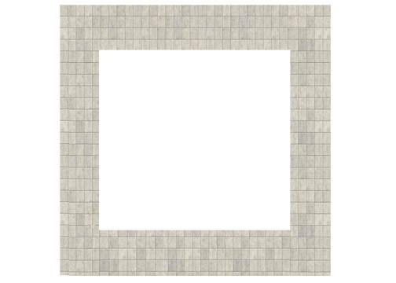
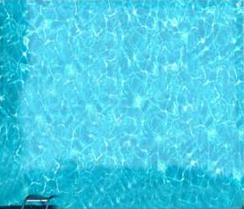



Around a square pool there is a footpath of width 2m. If the area of the footpath
is $\frac{5}{4}$ times that of the pool. Find the area of the pool.
x
( ) m
+ 4
+ 2
+ 2
Sol.
Let the length of the side of the pool be x m.
2m
x m
2m
Pool is in square shape
That means we need to find side of square pool
Area of square = (side)²
What we need to find?
What is area of square?
For Finding Area of Outer square we will have to find the length of side of outer square
(Area of the pool) =
x²
Area of the pool
Length of side of outer square = (x + 4)m
(Area of outer square)
We have 2 things
(Side)²
Area of the outer square = (x + 4)²
(Area of footpath)
$$\frac{5}{4}$$
(Area of pool)
=
?
2m
2m
(Area of footpath)
$$\frac{5}{4}$$
=
$$x2$$
(Area of the pool)
+
(Area of footpath)
=
(Area of outer square)

Slide 25




Around a square pool there is a footpath of width 2m. if the area of the footpath
is $\frac{5}{4}$ times that of the pool. Find the area of the pool.
64 × 5 = 320
‘-’ sign means subtracting
Sol.
Let the length of the side of the pool be x m.
Multiplying throughout by 4 we get,
Area of square = (side)²
5x²
– 32x
– 64
= 0
(Area of the pool) =
x²
∴ 5x²
– 40x
+ 8x
- 64
= 0
Length of side of outer square = (x + 4) m
∴ 5x
(x – 8)
+ 8
(x – 8)
= 0
Area of the outer square = (x + 4)²
Since last sign is ‘-’ Give middle sign to the bigger factor & opposite sign to smaller factor.
∴ (x – 8)
(5x + 8)
= 0
Find two factors of 320 in such a way that by subtracting factors we get middle number.
(Area of footpath)
$$\frac{5}{4}$$
=
(Area of pool)
∴ x – 8
= 0
or
5x + 8
= 0
∴ x = 8
or
x = $\frac{−8}{5}$
(Area of footpath)
$$\frac{5}{4}$$
x = $\frac{−8}{5}$ is not acceptable because side of pool cannot be negative
=
$$x2$$
(Area of the pool)
+
(Area of footpath)
=
(Area of outer square)
x²
+
$\frac{5}{4}$x²
=
(x + 4)²
32
∴ x = 8
320
∴ x² = 8²
x²
+ $\frac{5}{4}$x²
=
x² + 8x + 16
∴ x² = 64
$\frac{5}{4}$x²
–
0
+
∴
Area of pool is 64 sq.m.
– 8x
– 16
= 0
4
8

Slide 26
No. 54

Slide 27
QUADRATIC EQUATIONS
Word Problem on Rhombus

Slide 28
One diagonal of a rhombus is greater than other by 4 cm. If the area of the rhombus
is 96 cm², find the side of the rhombus.
A
D
Sol.
Let the length of other diagonal of a rhombus be ‘x’ cm.
The length of first diagonal is (x + 4) cm.
6
Area of rhombus
= $\frac{1}{2}$ × length of one diagonal × length of other diagonal
O
Calculation
As per the given condition,
8
Find two factors of 192 in such a way that by subtracting factors we get middle number.
96 =
$$\frac{1}{2}$$
x
2
192
B
C
×
×
x + 4
Hence, x = 12
; x + 4 = 12 + 4 = 16
2
In a comparative statement whatever comes later us taken as x
96
Let us do the prime factorization of 192
We know diagonals of a rhombus are perpendicular bisector of each other.
Considering oABCD a rhombus
In right angled ΔAOB,
‘-’ sign means subtracting
192
96
x 2
=
x²
+ 4x
192 × 1 = 192
Seg AC is a smaller diagonal
2
48
By Pythagoras theorem
192 = x² + 4x
l (AC) = 12 cm
0
=
x²
+
4x
– 192
2
24
[l(AB)]² = [l(A0)]² + [l(B0)]²
Seg BD is a bigger diagonal
+
–
[l(AB)]²
2
16
12
=
(6)²
+ (8)²
12
x² + 4x – 192 = 0
l (BD) = 16 cm
1
O is the intersection point of diagonal AC and BD
[l(AB)]²
x²
– 12x
+ 16x
– 192
= 0
2
6
=
36
+ 64
Since last sign is ‘-’ Give middle sign to the bigger factor & opposite sign to smaller factor.
16 - 12
=
4
x
(x – 12)
+ 16
(x – 12)
= 0
[l(AB)]²
3
3
=
100
(x – 12)
(x + 16)
= 0
l (AO) =
= 6cm
Taking square root on
both the sides we get,
1
x – 12 = 0
or
x + 16 = 0
l (AB) = 10 cm
x = 12
or
x = – 16
l (BO) =
= 8cm
The length of diagonal of the rhombus cannot be negative
∴
The side of a rhombus is 10 cm.
AOB is a right angled triangle.

Slide 29
No. 55

Slide 30
QUADRATIC EQUATIONS
Word Problem based on rectangular park

Slide 31
homework
EX 4.4 5
Q. Is it possible to design a rectangular park of perimeter 80 m
and area 400m² ? If so, find its length and breadth.
So let us solve the Quadratic Equation to find the length and breadth
Sol.
Let the Length of rectangle = x m
i.e. – x² + 40x – 400 = 0
Let us check the value of b² – 4ac
So let us assume for length and breadth
What we need to find?
and the breadth of rectangle
=
y m
i.e. x² – 40x + 400 = 0
It is given that ..
We know that
Perimeter of a rectangle = 2(length + breadth)
We know that
Area of a rectangle = length × breadth
∴
According to the given condition,
So, to make the situation possible the
equation should contain real roots.
Perimeter
=
80 m
2(length + breadth)
80 m
=
b² – 4ac
= (– 40)² – 4 × 1 × 400
∴
2(
x
+
y)
=
80
= 1600 – 1600
∴
x + y
=
40
= 0
∴
y
=
40 – x
b² – 4ac
= 0
So, length of given rectangle = x m
and, breadth of given rectangle = (40 – x)m
So, the given equation has two equal
real roots.
According to the given condition,
Area of rectangle is given as 400 m²
Hence the situation is possible.
(length)
(breadth)
=
400
i.e.
(x)
(40 – x)
=
400
∴
40x
–
x²
= 400

Slide 32
Q. Is it possible to design a rectangular park of perimeter 80 m
and area 400m² ? If so, find its length and breadth.
From last two ‘20’ is common along with 3rd term sign
Sol.
Solving the quadratic equation x² – 40x + 400 = 0 by factorisation method
From first two ‘x’ is common
= 20 × 20
400
To factorise by splitting middle term
1 × 400 = 400
x² – 40x + 400 = 0
Standard form
1
∴ x² – 20x – 20x + 400 = 0
Find product of 3rd no. with 1st no.
1st no.
3rd no.
20 + 20 = 40
middle no.
–
Factorise by splitting middle term
–
∴ x
(x – 20)
– 20
(x – 20)
= 0
20
20
Product of two brackets is zero
Find two factors of 400 in such a way
∴ (x – 20) (x – 20) = 0
Now signs to be given to both factors
Either (x – 20) = 0 or (x – 20) = 0
‘+’ sign means adding
that by adding factors we get middle no.
∴ x – 20 = 0
or
x – 20 = 0
∴ x = 20
or
x = 20
Since, last sign is +
Give middle sign to both the factors
When x = 20, 40 – x = 40 – 20 = 20
∴
Length of the rectangular park = 20m and
breadth of the rectangular park = 20 m
∴
$$\text{The} \text{park} \text{is} \text{a} \text{square} \text{having}\text{ 20}\text{m} \text{side}\text{.}$$

Slide 33
No. 56

Slide 34
QUADRATIC EQUATIONS
Word Problem based on Geometric figure (Rectangle)

Slide 35
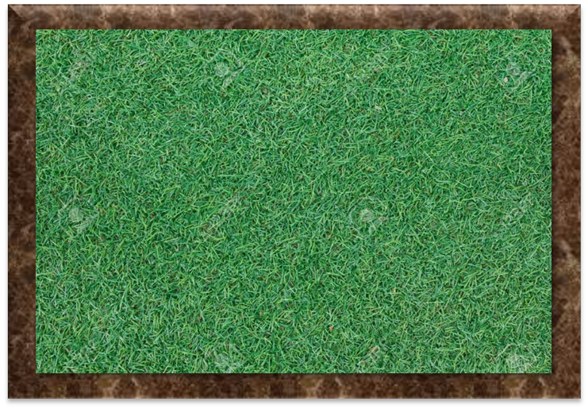
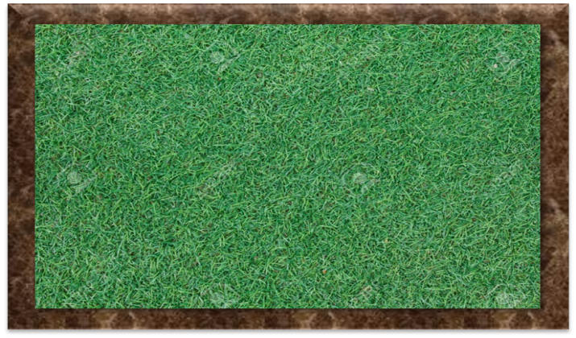





12.
A rectangular playground is 420 sq.m. If its length is increased by 7m and breadth is decreased by 5 metres, the area remains the same.
Find the length and breadth of the playground ?
Sol.
Let the length of a rectangular playground be ‘x’ m.
We know that
Dividing throughout by 5
Area of rectangle = length × breadth
We are considering a rectangular playground
x²
Length and Breadth are unknown
1
+ 7x
– 588
= 0
420 =
x
What do we have to find ?
× breadth
x²
+ 28x
– 21x
– 588
= 0
= breadth
x
588
Calculation
(x + 28)
– 21
(x + 28)
= 0
Area of new rectangle = length × breadth
(x + 28)
(x – 21)
= 0
2
x + 28 = 0
or x – 21 = 0
588
420
=
x
×
(
+
7
)
x = – 28
or x = 21
+
28
–
21
2
294
42
–
The length of playground cannot be negative
28
–
14
$≠$ 7
(
21
= 7
3
147
x
x m
+
7
)
420
=
x
m
+
7
Since we are subtracting the factors give middle term sign to the bigger factor and the opposite sign to the smaller factor
7
49
420 sq.m
$$\frac{420}{x}−5$$
x ≠ – 28
Find two factors of 588 in such a way that by subtracting factors we get middle no. 7
Hence, x = 21
420
=
420
– 5x
+
– 35
$$\frac{420}{x}$$
Let’s do the prime factorisation of 588
7
7
Multiplying throughout by x, we get;
= $\frac{420}{x}$
= $\frac{420}{21}$
Breadth
= $20$
1
0 =
–5x²
+ 2940
– 35x
5x² + 35x – 2940 = 0
∴ The length of rectangular playground is 21m and its breadth is 20m.

Slide 36
No. 57

Slide 37
QUADRATIC EQUATIONS
Word Problem based on Geometric figure (Polygon)

Slide 38
Q)
Exterior angle of a regular polygon having n-sides is more than that of the polygon having n² sides by 50⁰ . Find the number of the sides of each polygon.
Sol.
REMEMBER !!!!!
Exterior angle of any regular polygon is given by the formula 360/number of sides
Number of sides of one of the regular polygon = n
Find two factors of 180 in such a way that by adding factors we get middle no. 36
Since we are adding the factors give middle term sign to both the factors.
Equilateral triangle is a 3 sided regular polygon
36 × 5 = 180
Number of sides of the other regular polygon = n²
30
+
6
= 36
‘n’ sided closed figure having all the sides equal
After the sign 50
After leaving some space +
Exterior angle for a regular polygon =
Means =
Equilateral ∆ (3 sides)
Multiplying throughout by –1
Square is 4 sided regular polygon
Exterior angle for a regular polygon having ‘n’ number of sides =
360
=
120⁰
Exterior angle for a regular polygon having ‘n²’ number of sides =
3
As per the given condition,
18
0
(n – 6)
120⁰
∴ 5n
(n – 6)
– 6
= 0
∴ n = $\frac{6}{5} is not acceptable$
60⁰
=
+
50
∴ (n – 6)
(5n – 6) = 0
Multiplying throughout by n²
∴ n – 6 = 0
or 5n – 6
= 0
∴ n = 6
Square (4 sides)
–
–
3
6
∴ 360n
= 360
+ 50n²
0
∴ n² = (6)²
= 36
Dividing throughout by 10
∴ n = 6
or 5n = 6
∴ 36n
= 36
+ 5n²
360
or n = $\frac{6}{5}$
=
90⁰
∴ n = 6
∴ Number of sides of required polygons are 6 and 36.
∴ –5n²
+ 36n
– 36
4
= 0
Number of sides cannot be a fraction.
∴ 5n²
– 36n
+ 36
= 0
∴ 5n²
– 30n
– 6n
+ 36
= 0

Slide 39
No. 58

Slide 40
QUADRATIC EQUATIONS
Word Problem based on Geometric figure (Hexagon)

Slide 41

Q)
The side of one regular hexagon is larger than that of the other regular hexagon by 1cm. If the product of their areas is 243, then find the sides of both the regular hexagons.
Sol.
Let the side of the smaller regular hexagon be x cm.
The side of larger regular hexagon will be x + 1
The side is larger by 1 cm
The side of the bigger regular hexagon is (x + 1) cm.
So, the area of larger regular hexagon will be
Let us consider two regular hexagons. One smaller and one bigger
A hexagon is a 6-sided polygon
It is given that……
Let the side of a smaller regular hexagon be x
The side of a larger regular hexagon will be x + ?
Hexagon having all sides equal
So, the area of smaller regular hexagon will be
What we have to find ?
Means multiplication
As per the given condition
What is a hexagon ?
Area of regular hexagon = × (side)²
$$\frac{3\sqrt{3}}{2}x2$$
$$\frac{3\sqrt{3}}{2}\left(x+1\right)2$$
$$×$$
$$=243$$
x²
(x + 1)²
x
x
+
1
x²
×
(x + 1)²
=
243

Slide 42































Q)
The sides of one regular hexagon is larger than that of the other regular hexagon by 1cm. If the product of their areas is 243, than find the sides of both the regular hexagons.
Since we are subtracting the factors give middle term sign to the bigger factor and the opposite sign to the smaller factor
Let the side of the smaller regular hexagon be x cm.
∴
$$x(x+1)$$
$$= 6$$
The side of the bigger regular hexagon is (x + 1) cm.
As per the given condition
∴
$$x2$$
$$+ x$$
$$= 6$$
Find two factors of 6 in such a way that by subtracting factors we get middle no. 1
6
∴
$$x2$$
$$+ x$$
$$–6$$
1
1
$$=0$$
$$\frac{3\sqrt{3}}{2}x2$$
$$\frac{3\sqrt{3}}{2}\left(x+1\right)2$$
∴
$$x2$$
$$+3x$$
$$–2x$$
$$–6$$
$$=0$$
$$×$$
$$=243$$
∴
$$x$$
$$(x+3)$$
$$–2$$
$$(x+3)$$
$$=0$$
$$9$$
$$×3$$
–
+
∴
$$(x+3)$$
$$(x –2)$$
$$=0$$
∴
$$× x2$$
$$\left(x+1\right)2$$
$$=243$$
2
3
$$4$$
∴
$x+3 =0$
or $x−2 =0$
$$81$$
$$9$$
$$× \frac{4}{9 ×3}$$
∴
$$x= –3$$
$$or$$
$$x=2$$
∴
$$=243$$
$$\left[x\left(x+1\right)\right]2$$
∴
$$1$$
$$1$$
$$x≠–3(as side cannot be negative)$$
∴
$$\left[x\left(x+1\right)\right]2$$
$$=36$$
$$Hence x=2$$
$$Taking square root on both the sides, we get,$$
∴
$$x+1$$
$$=2+1$$
$$=3$$
$$x(x+1)$$
$$= ±6$$
$$x\left(x+1\right)= –6 is not acceptable because$$
$$product of sides of a hexagon cannot be negative$$
∴
$$The sides of both the regular hexagon$$
$$are 2cm and 3cm.$$

Slide 43
TThank Youk You

